Slide 1
Predicting Accident Severity

Slide 2
Predicting Accident Severity is very important
It saves lives of many individuals
Individuals can plan alternatives for their travel in advance.
Road safety organizations can arrange for additional safety at accident prone zones and times.

Slide 3
Data acquisition and cleaning
Data has been obtained from Kaggle.
Primarily Captures Road Accidents in UK between 1979 and 2015 and has 70 features/columns and about 250K rows.
Two Data frames has been created.
One includes weather features and the other does not.

Slide 4
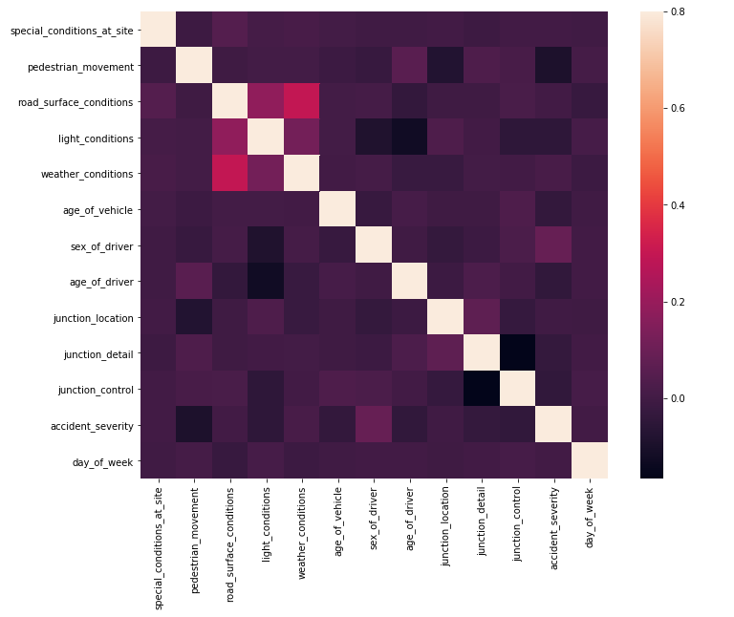
Using Heat Map for Feature Selection

Slide 5
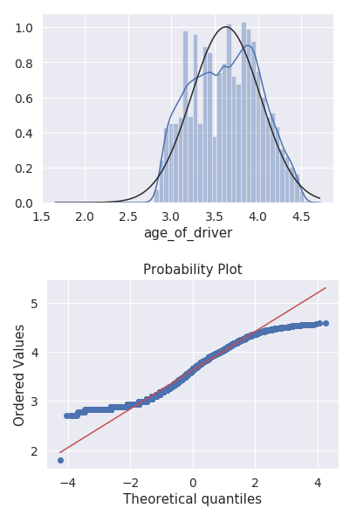
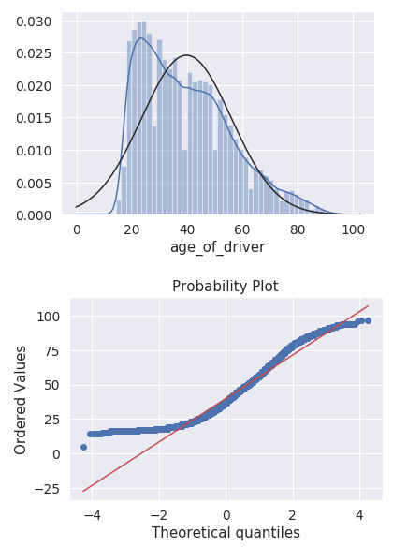
Normalizing Driver Age and Vehicle Age

Slide 6
Conclusion and future directions
Built useful models to predict Severity of an accident.
Accuracy of the models has room for improvement.
Capture more data on accidents.
Ideas include:
Regional Data
Yearly Data

